Slide 1
UCare Medicare Group
For PEIP Retirees and Spouses

Slide 2

Our members speak for themselves
132K
96%
20+
People on Medicare trust us to provide health care coverage
Of our Medicare members stay with us year after year
Years we’ve been offering Medicare Advantage plans
UCare was the first to offer Medicare Advantage Plans in Minnesota

Slide 3
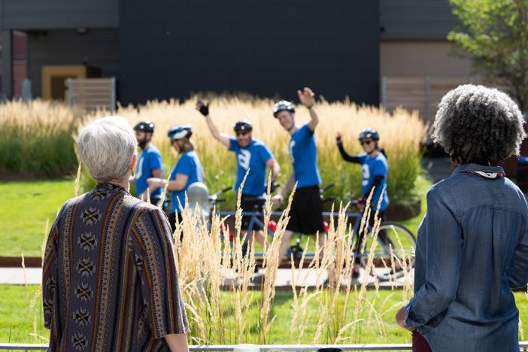
Advantages of UCare Medicare Plans
Network
We have a large statewide network including Mayo Clinic
Choice
Three plan option to fit your needs and
your budget
Customer Service
We are local — just call to talk with us
Convenience
Medical and Medicare Part D all in one plan
Lots of extras
Over-the-counter allowance, dental, vision
and hearing benefits and fitness programs

Slide 4
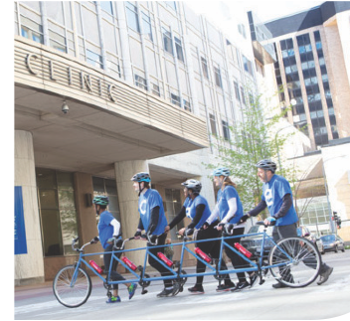
96% of all MN providers in network
Allina Health
CentraCare
Entira Family Clinics
Essentia Health
M Health Fairview
Mayo Clinic
North Memorial Health
Park Nicollet
Sanford Health
St. Luke’s
Stillwater Medical Group
University of Minnesota
Voyage Healthcare
Winona Health
and many more with no referrals needed

Slide 5
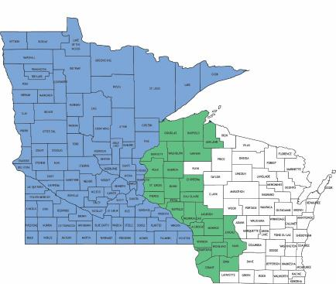
Who can join UCare Group Medicare?
Retirees and their spouses who:
  Have Medicare Part A and Part B
  Continue to pay Part B premium
  Live in Minnesota or within 26
  counties in Wisconsin

Slide 6
UCare Medicare Group Premium Rates
High
$342
Core
$177
Basic
$79
Rates are per member, per month
through 12/31/22

Slide 7

Preventive Benefits
Health Services- $0 copay
  Annual Physical
  Routine Tests
  Dental Services – 100% coverage
  3 cleanings
  2 exams
  Annual bitewing X-rays
Notes:
Almost every primary care clinic is in our network! Your chosen clinic is just a home base – your doctor does not have to approve, refer, or sign off on anything for you to see whoever you want. Yes, ALMOST every primary care clinic, the few primary care clinics of HealthPartners are not within our network, but the specialty and urgent care HealthPartners clinics are. For those that use the internet, it’s best to click Find a Doctor on UCVare.org to search for your doctor in the network. Choose UCare for Seniors as your plan.

Slide 8

Primary Doctor Visits
Choose a Primary Care Clinic
  Keep your doctor, your clinic
  Find in Primary Care Clinic Listing
  Change clinic anytime
  Just a home base
  Primary Office Visit
  $0 copay on all plans
Notes:
Almost every primary care clinic is in our network! Your chosen clinic is just a home base – your doctor does not have to approve, refer, or sign off on anything for you to see whoever you want. Yes, ALMOST every primary care clinic, the few primary care clinics of HealthPartners are not within our network, but the specialty and urgent care HealthPartners clinics are. For those that use the internet, it’s best to click Find a Doctor on UCVare.org to search for your doctor in the network. Choose UCare for Seniors as your plan.

Slide 9

Specialist Doctor Visits
See any Specialist
  No referral needed
  Simply make an appointment
  Use Find a Doctor tool
  Specialist Office Visit
  High - $15 copay
Core - $30 copay
  Basic - $40 copay

Slide 10

Inpatient Hospital
Covered at 100% after copay
  High – $100 copay per admission
  Core – $125 copay per admission
  Basic – $400 copay per admission
We coordinate with all providers,
no paperwork

Slide 11

Outpatient Services and Skilled Nursing
Skilled Nursing Facility Care
  No three-day in-patient hospital stay requirement
  $0 for days 1 through 20
  $100 per day for days 21 through 100
Outpatient Services
  High – $200 copay
  Core – $250 copay
  Basic – $250 copay

Slide 12


YES! Coverage when you travel –3 ways
Out of State Providers with MultiPlanTM Network
Expanded national network of providers
Same great coverage as in network
UCare AnywhereSM travels with you in the U.S.
Pay the same in-network copay for most office visits
Coverage for other non-emergency services
Emergency coverage worldwide
Travel out of area up to 6 consecutive months
No need to notify us of your coming and goings

Slide 13


Are my prescription drugs covered? – Part D
Find your drugs
Search online or our formulary
4 tiers of coverage
NEW for 2023:
Most Part D vaccines are no cost to you
Insulin no more than $35 per 30-day supply
Both regardless of whether you have paid your deductible
Fill your prescriptions
60,000 pharmacies:
Preferred and Mail Order
Get a 90-day supply for 2 copays -Includes Cub, CVS, Costco, Sam’s Club and more!
Standard
Access to an additional 42,000 local
and nationwide chain pharmacies

Slide 14
Initial Coverage Stage
From $0 to $4,430 in annual prescription drug costs | High | Core | Basic
Annual deductible Tier 1 – Generic Tier 2 – Preferred Brand Tier 3 – Non-Preferred Tier 4 – Specialty Drugs | $0 $10 copay $40 copay $100 copay 30% coinsurance | $200* $12 copay $45 copay $100 copay 25% coinsurance | $395* $12 copay $45 copay $100 copay 25% coinsurance
*Tier 1 Generic drugs are not subject to meeting the deductible

Slide 15
Coverage Gap Stage – Donut Hole
Once you have reached $4,430 in annual prescription drug costs | High | Core | Basic
 | This plan has Gap Coverage Continue to pay copays as usual | Continue to pay Tier 1 copays as usual You pay 25% of the cost of brand name drugs | You pay 25% of the cost of generic drugs You pay 25% of the cost of brand name drugs
Once you reach $7,050 in out of pocket costs: Catastrophic Coverage
You pay a low copay or 5% coinsurance, whichever is greater

Slide 16


Additional Benefits – Vision and Hearing
  Routine Vision exam – $0 copay
  Diagnostic exam - $0 to $40 copay
  $150 eyewear reimbursement
  each calendar year
  Routine Hearing exam – $0 copay
  Diagnostic exam - $0 to $40 copay
  Two TruHearing hearing aids per year- copay varies from $499 to $999

Slide 17
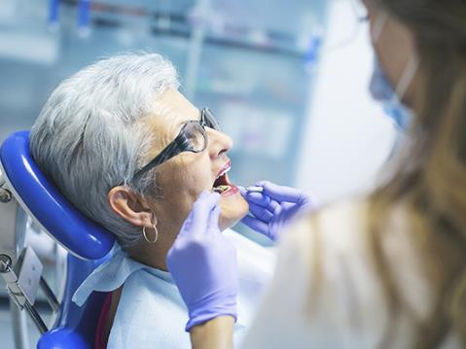

Additional Dental Benefits
Preventive dental included
  3 cleanings, 2 exams, and x-rays
Additional dental coverage for
$25 per month
  Coverage for fillings, crowns, implants
  $50 deductible
  $2500 annual maximum

Slide 18


Fitness Benefits
Health Club Savings
  One Pass™ fitness program
Nearly 30,000 social activities, community classes, and events available for online or in-person participation
More than 20,000 on-demand and live-streaming fitness classes
Workout builders to create your own workouts
A Home Fitness Kit available
Personalized, online brain training program to help improve memory, attention and focus
If you belong to a participating health club that is not in the One Pass network, you may receive a reimbursement of up to $30 in your monthly health club membership fees.
Notes:
SilverSneakers Fitness Program
Use at any nearby participating location, and even when traveling.
Includes:
• A free basic fitness membership at more than 16,000 locations in the SilverSneakers network
• Online support
• SilverSneakers FLEXTM fitness classes
• At-home fitness kit options for stress relief, strength, walking, and yoga
Health Club Savings
Join a class, work with weights, swim some laps, or try something new. Health Club Savings offers the variety you want and the flexibility you deserve. If you belong to a participating health club that is not in the SilverSneakers network, you can receive a reimbursement of up to $20 in your monthly health club membership fees.

Slide 19
More Additional Benefits
  Over-the-Counter Benefit
  $50 bi-annually toward over the counter items.
  Purchase online or at Walmart or CVS
  Use or lose within the 1/1-6/30 and 7/1-12/31 window
  Minnesota Community Education Discount
  Get up to a $15 discount on most Minnesota community education classes, like fitness, cooking or learning new language.
  3 discounted classes each year.
Notes:
SilverSneakers Fitness Program
Use at any nearby participating location, and even when traveling.
Includes:
• A free basic fitness membership at more than 16,000 locations in the SilverSneakers network
• Online support
• SilverSneakers FLEXTM fitness classes
• At-home fitness kit options for stress relief, strength, walking, and yoga
Health Club Savings
Join a class, work with weights, swim some laps, or try something new. Health Club Savings offers the variety you want and the flexibility you deserve. If you belong to a participating health club that is not in the SilverSneakers network, you can receive a reimbursement of up to $20 in your monthly health club membership fees.

Slide 20
How to join UCare Medicare Group
Retirees and Spouses
  May enroll when Medicare-eligible and retired
  Each fills out and application and plan choice form
Enrollment Folders
  Includes 2 applications and 2 plan choice forms
  Mail forms in the green envelope provided
Contact Us to Have Enrollment Folder sent to you.
612-676-6900
Toll Free 877-598-674
groupsales@ucare.org

Slide 21
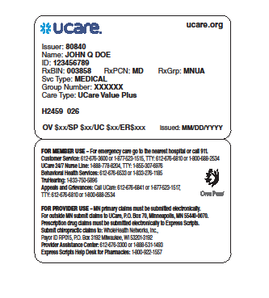
Welcome to UCare!
Confirmation of enrollment
Member ID card
Customer Service
UCare 24/7 Nurse Line
Disease Management
Programs
Member Portal at UCare.org

Slide 22
Questions about UCare Medicare Group
Contact us:
Amy Sundem – Group Sales Representative
Debbie Holt – Group Sales Manager
  Phone: 612-676-6900
  Toll Free: 1-877-598-6574
  Email: groupsales@ucare.org

Slide 23


THANK
YOU
Happy Retirement!
www.ucare.org

